Slide 1


An analysis of maximum parsimony algorithms to predict parasitism in Eukaryota using a large multifurcated phylogenetic synthesis tree
Thesis of Lydia Buntrock
Supervisors:
Prof. Dr. Bernhard Y. Renard
Prof. Dr. rer. nat. Emanuel Heitlinger
8.5.2018
Notes:
Welcome to the defence of my master thesis.
It is about the analysis of maximum parsimony algorithms to predict parasitism in Eukaryota.
I used a big phylogenetic synthesis tree for that.

Slide 2
Structure
Motivation & Goal
Definitions & Methods
Results
Discussion
References
An analysis of maximum parsimony algorithms to predict parasitism in Eukaryota using a large multifurcated phylogenetic synthesis tree
Notes:
First I wanna go along this title with the focus on the real reconstruction.
First, I explain my motivation and give some definitions (MP, parasites,…).
I will briefly state some methods to then respond to my results.
Finally, I would like to go into a few discussion points of my work.
Definitions / Methods: OTL, GloBI, Ancestral state reconstruction (Sankoff/castor), Simulation, Leave-100-out cross-validation
Results: Availability of data, Simulation?, Leave-100-out cross-validation
Discussion: data is grouped and not uniformly distributed

Slide 3
Motivation
Identify in a sample of species the parasites.

Slide 4
Motivation
Identify in a sample of species the parasites.
Goal
Find an algorithm to predict unknown species as parasites in a relationship tree.
→ Application of maximum parsimony algorithms to non-binary trees and very large datasets to predict unknown leaf node states.

Slide 5
Data
Species states (data for nodes):
Global Biotic Interactions (GloBI)
→ parasitism / free-living state for leaf nodes (species)
Relationships (phylogenetic tree):
Synthesis tree from Open Tree of Life
Notes:
Predict parasitism
-> of which specie we know the state? (distinguish parasite / free-living)
–> need relationships of all Eukaryota species – use these for prediction
Present two databases

Slide 6
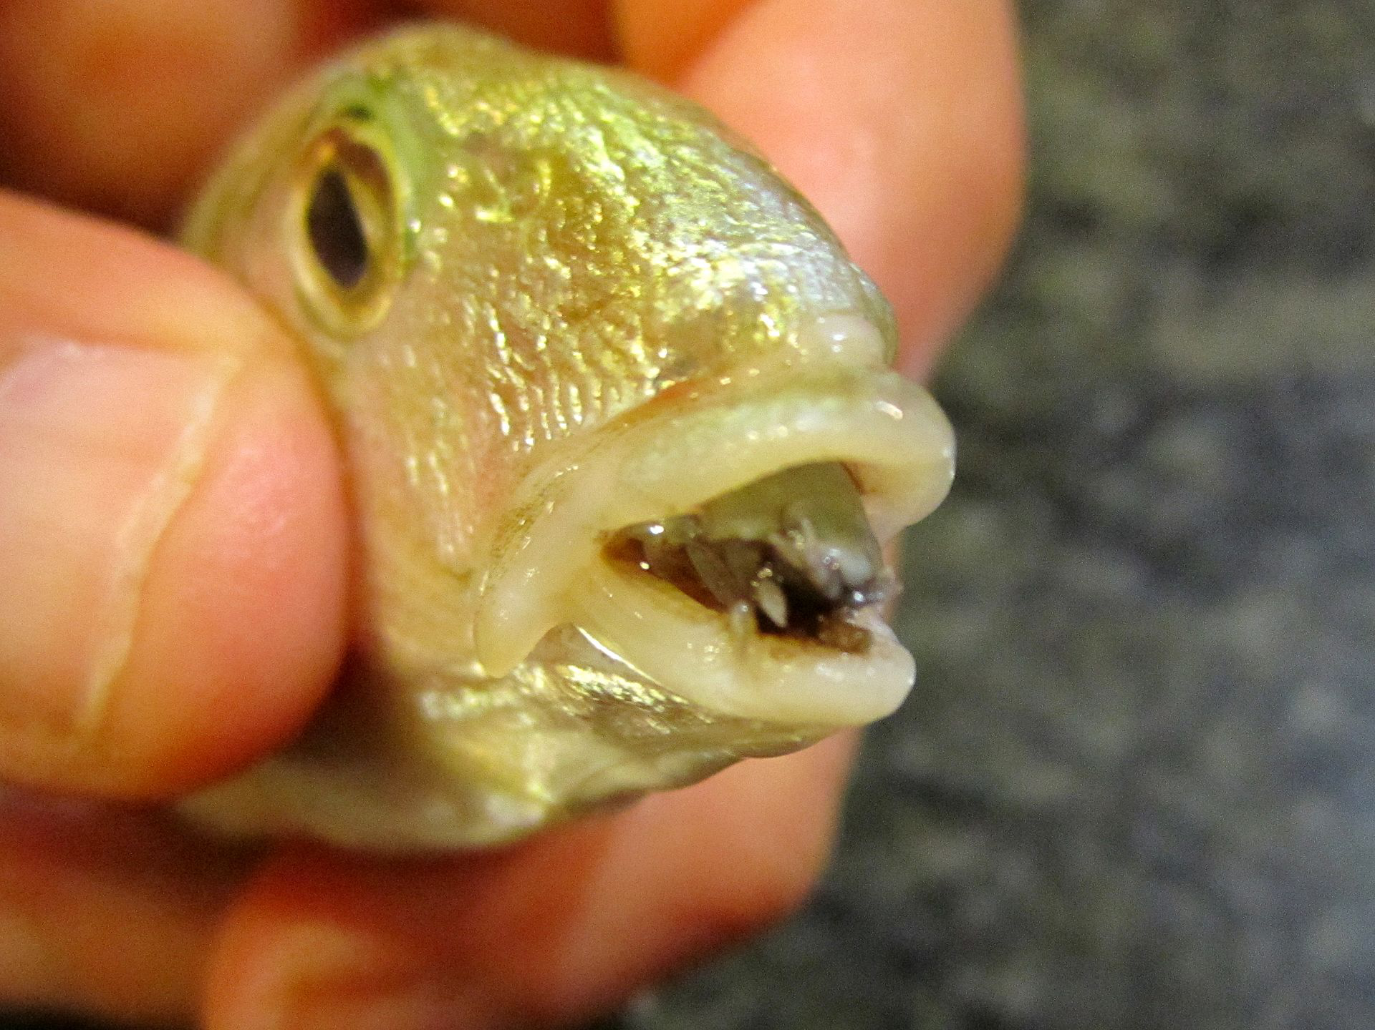
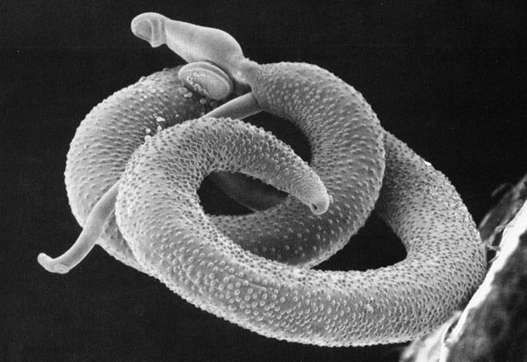
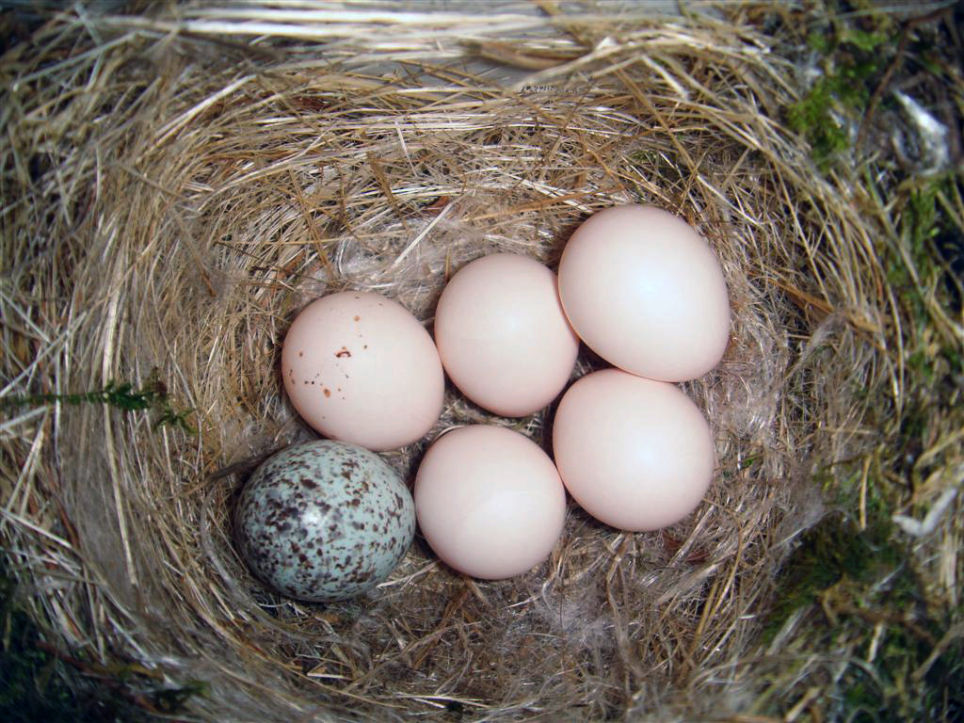
Definitions – Parasitism
Parasitism is an interaction relationship between two organisms living together in more or less intimate association in a relationship in which association is disadvantageous or destructive to one of the organisms.
40% of species are parasites, but the most of them are understudied.
Notes:
Da ich mich auf parasite spezialisiert habe möchte ich zunächst die definition von parasitismus geben.
(Parasitism can be defined as an interaction between species in which one of the interaction partners, the parasite, lives in or on the other, the host. The parasite draws food from its host and harms it in the process.)
Since we use GloBI to classify species, we use their definition of parasitism. In GloBi, Ontobee definitions are used [16]. The interaction
has parasite is defined as: …
According to estimates, above 40% of all Eukaryota are parasites.

Slide 7

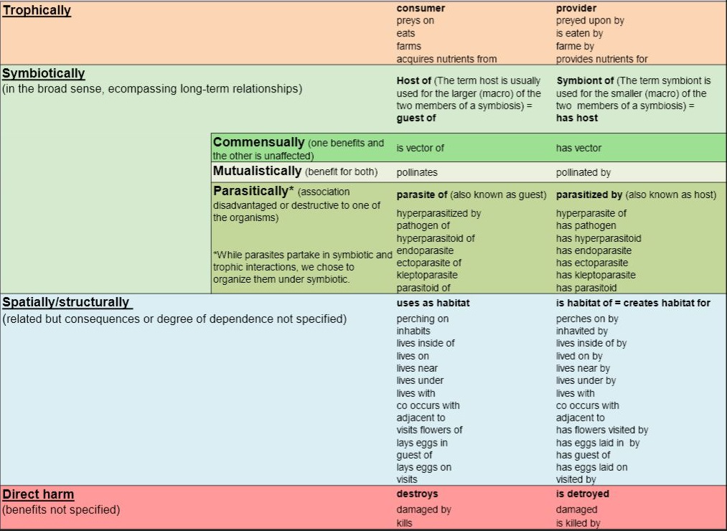
Global Biotic Interactions (GloBI)
https://www.globalbioticinteractions.org/
Notes:
As I mentionted (erwähnt) I used GloBI….
The data in GloBI is stored as interactions e.g. species A is host of species B. We conclude that species A is free-living and species B parasitic.

Slide 8
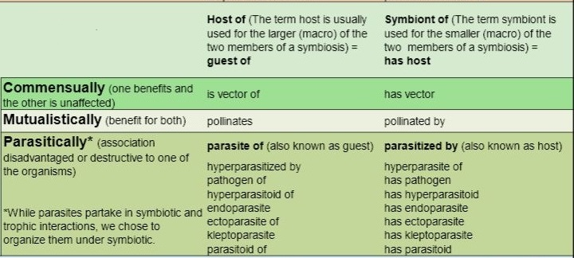
Global Biotic Interactions (GloBI)
https://www.globalbioticinteractions.org/?interactionType=interactsWith&targetTaxon=Cymothoa%20exigua
→ Cymothoa exigua (tongue-eating louse) parasite of Spottail grunt (fish)
→ 34,860 free-livings & 25,962 parasites (of 2.3 million leaf nodes)
Notes:
Deeper look to these so called ‘symbiotically’ interactions…
One example: the already mentioned tongue-eating louse, which parasitize some fishes… (web interface) conclude fish is free-living
From this data, we could specify 34,860 as free-living and 25,962 as parasitic.
-> we have a total of 2.3 million leaf nodes -> (97.34%) leaf nodes without state information.

Slide 9
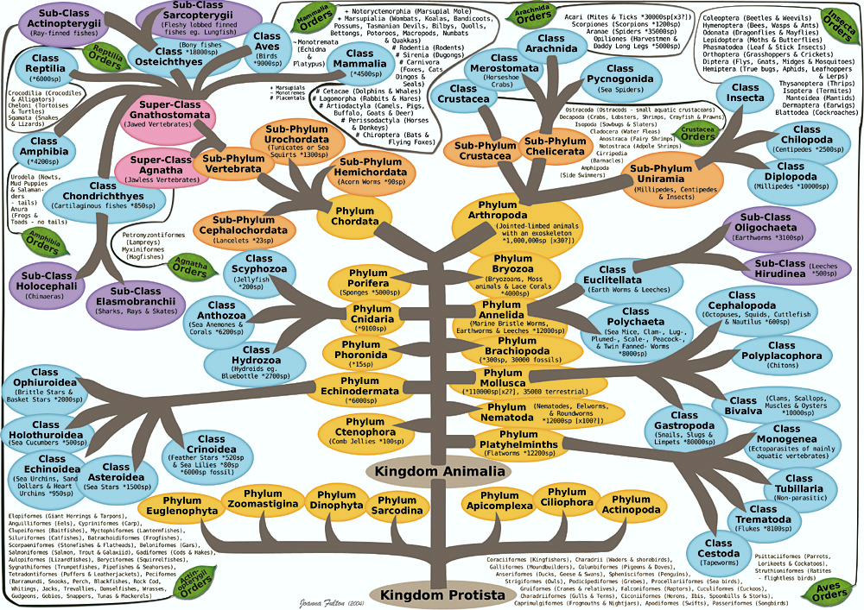
Definitions – Taxonomic tree
Notes:
Classification scheme with criterions also called Taxa
Different ranks like: kingdom, phylum, class, order…
rough subdivision, this tree is of cause not binary, which means every node has normally more than two children
Eine Taxonomie ist ein einheitliches Verfahren oder Modell (Klassifikationsschema), mit dem Objekte nach bestimmten Kriterien klassifiziert, das heißt in Kategorien oder Klassen (auch Taxa genannt) eingeordnet werden.[1] Naturwissenschaftliche Disziplinen verwenden den Begriff der Taxonomie für eine in der Regel hierarchische Klassifikation (Klassen, Unterklassen usw.).

Slide 10
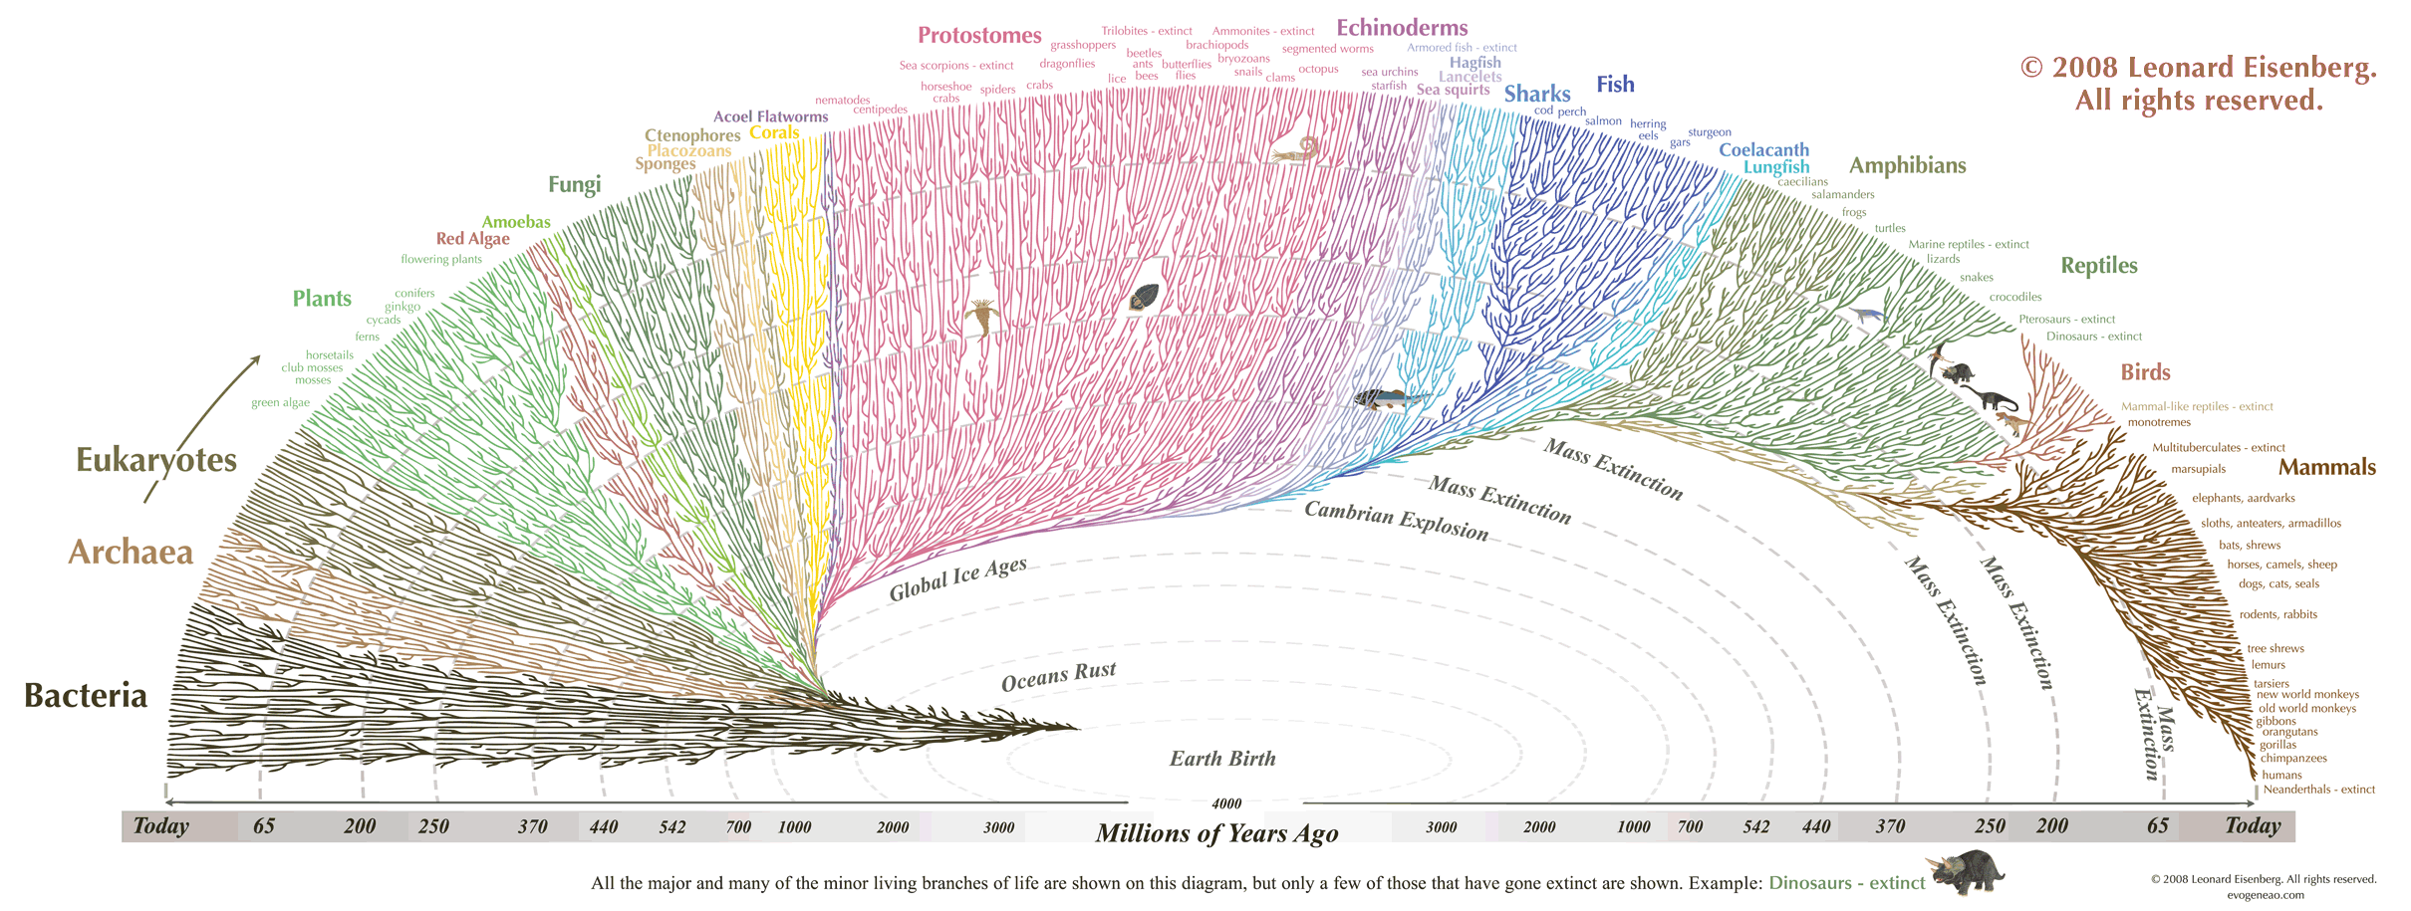
Definitions – Phylogenetic tree
Phylogenetics:
study of evolutionary history
relationships among individuals or groups of organisms
Result: phylogeny / phylogenetic tree
→ data structure as hypothesis about the history of the evolutionary relationships of a group of organisms
Notes:
finer subdivision
The result, a phylogenetic tree, is a binary tree
In our case the Eukaryota

Slide 11
Open Tree of Life
"Synthesis of phylogeny and taxonomy into a comprehensive tree of life.“
https://tree.opentreeoflife.org
Eukaryota tree of OTL has 2,293,463 leaf nodes
And 241,974 internal nodes
Trees in synthesis: 819
→ not nearly binary
Notes:
Open Tree of Life (OTL), a synthesis of phylogenetic trees on a backbone taxonomy

Slide 12
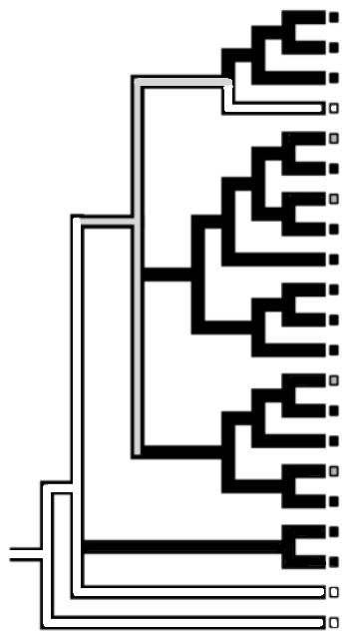
Methods for ancestral-state reconstruction
→ maximum parsimony algorithms:
Explain the current state with the least number of state changes between the child and his ancestor
Fitch parsimony
Sankoff parsimony
Notes:
There are different methods of ancestral-state reconstruction.
We decided to use maximum parsimony algorithms, which means:
explain the current state with the least number of state changes between the child and its ancestor.
Other possible methods are for example, to use a stochastic process to model the character evolution of the states. (sometimes called likelihood methods)
We decided for MP, because they are simple and generalized and the most advantages for other methods don’t play a role in out case.
Example is here: divergence times (branch length) can not be used. Since the OTL does not include development times of species, this can not be considered here.
(Transision probabilities….
This problem is unimportant to the present task because in the analysis of the entire Eukaryota tree only generalized models are meaningful. The comparison of methods gives us the maximum parsimony method as the simplest and fastest method that meets all our requirements.)
We can distinguish two methods for our given goal: Fitch and Sankoff parsimony.
I tested both. I implemented Fitch and used the implementation of Sankoff (which can be accessed by an R package named castor).
Sankoff makes the more accurate predictions.

Slide 13
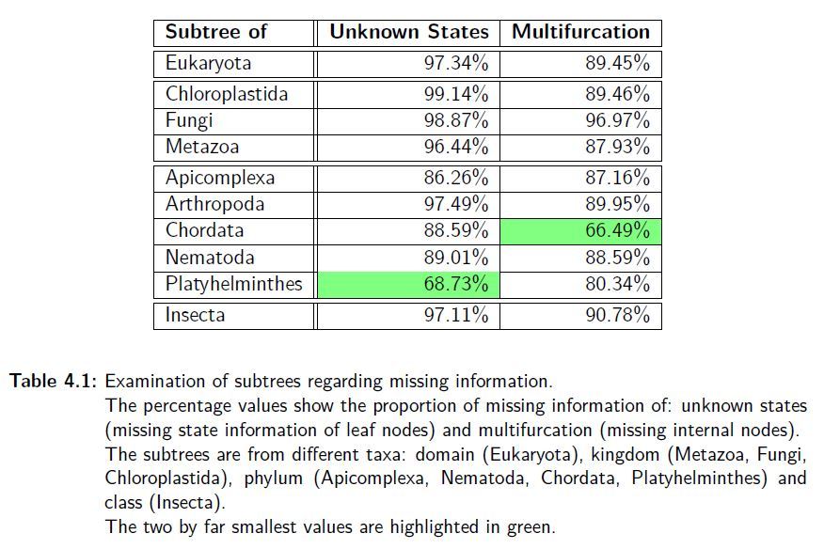
RESULTS
OTL: multifurcation of 89.45%
GloBI: only 2.66% of the node information
Some subtrees have much more information.
→ Data is highly variable?
Notes:
For this reconstruction, we first analyzed our input data.
Open Tree of Life (OTL) gives us the greatest approximation to a phylogeny of the Eukaryota.
… only a synthesis of phylogenetic trees with a taxonomy as a backbone.
… far from binary … multifurcation of 89.45%
Global Biotic Interactions (GloBI) database … only 2.66% of the node information.
Finally, we analyzed the validation of our ancestral state reconstruction results. We will do a
statistical analysis from the tree and some selected subtrees and consider the leave-100-out
cross-validation. Of these omitted nodes, we predict 98.17% correctly.
However, this is highly variable and therefore the reconstruction is still very good on wide parts of the tree.

Slide 14
Leave-100-out Cross-validation
Randomly left out 100 states 100 times
Of these 10,000 nodes were 9,238 unique (~15% of all nodes)
predicted 98,17% correct
Variance: 0.017 (no large amounts of input states)
Notes:
For a further validation of our results, we carried out a leave-100-out cross-validation.
In order to achieve about 15% of the 60,871 input node states with a validation, we randomly left out 100 states 100 times.
Omitting smaller amounts of states up to leave-one-out had too much computational effort.
Of these 10,000 nodes, 9,238 are unique.
From the unique nodes, we predicted approximately 98.17% correct and thus 1.82% wrong, with duplicate draws always having the same prediction.
The associated variance is 0.017, which means that no large amounts of input states have to be omitted.

Slide 15
Discussion
Adoption: data is grouped and not uniformly distributed
The data in the direction of the root node are probably unreliable.
→ localization of origins is difficult
How much does this affect the estimation of the number of origins?
Our counts are similar in scope to others, but they are difficult to pin down.
Notes:
From the simulation, we can conclude that we predict about 60% of the nodes in the present data situation correctly.
The leave-100-out cross-validation even showed that we predict the omitted nodes to be 98.17% percent correct.
This allows for the assumption that the data is grouped and not uniformly distributed
-> thus smaller subtrees are present in which data are to be found in the simulation with smaller multifurcation and smaller value for unknown nodes.
However, it follows that the ancestral states’ data in the direction of root node are probably particularly unreliable.
This makes the localization of origins in direction of the root node difficult.
The question remains, how much this affects the estimation of the number of origins.
Our comparison with the paper from Weinstein and Kuris [18] an with Blaxter and Koutsovoulos [21] showed similar numbers of origins in some subtrees, which leaves us with optimism.

Slide 16
References
Independent origins of parasitism in Animalia (Sara B. Weinstein and Armand M. Kuris)
Global biotic interactions: An open infrastructure to share and analyze sepcies-interaction datasets (Jorrit H. Poelen, James D. Simons, Chris J. Mungall)
Tangled trees - Phylogeny, Cospeciation, and Coevolution (Book by Roderic D. M. Page)
Choosing the best ancestral character state reconstruction method ( Manuela Royer-Carenzi, Pierre Pontarotti, Gilles Didier – 2012)
Synthesis of phylogeny and taxonomy into a comprehensive tree of life (Hinchliff, Cody E., et al. - 2015)

Slide 17
References
Parasites - https://en.wikipedia.org/wiki/Parasitism
Animalia Phylum Tree by opelate http://opelate.deviantart.com/art/Animalia-Phylum-Tree-20118810 (4.7.2017)
The Tree of Life - Edward Tufte forum: Evidence and assumptions in cladograms https://www.edwardtufte.com/bboard/q-and-a-fetch-msg?msg_id=00018e (4.7.2017)
All other references can be found in the master thesis.

Slide 18
Thank you for your attention!
Questions?

Slide 19
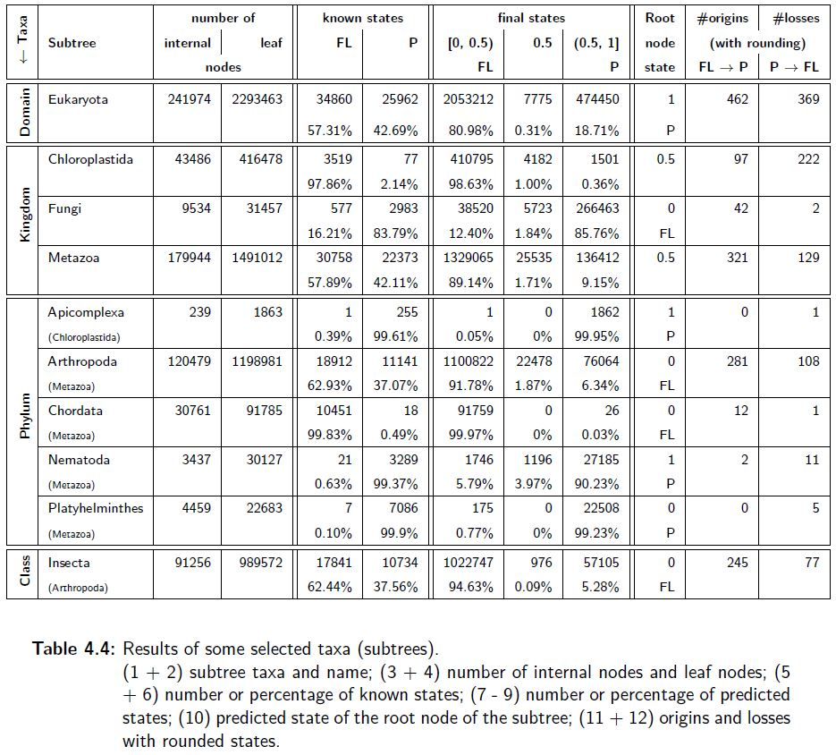
Results

Slide 20

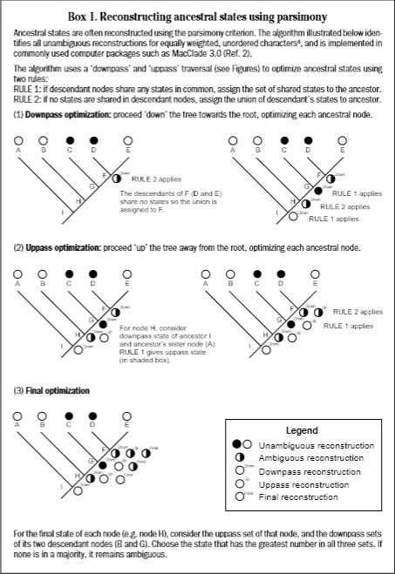
Fitch maximum parsimony

